Slide 1
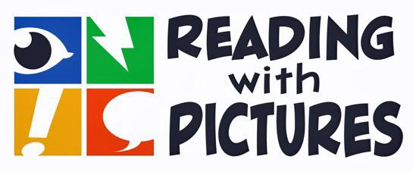
Integrating Comics Into the Common Core
presented by Tracy Edmunds, M.A. Ed.

Slide 2
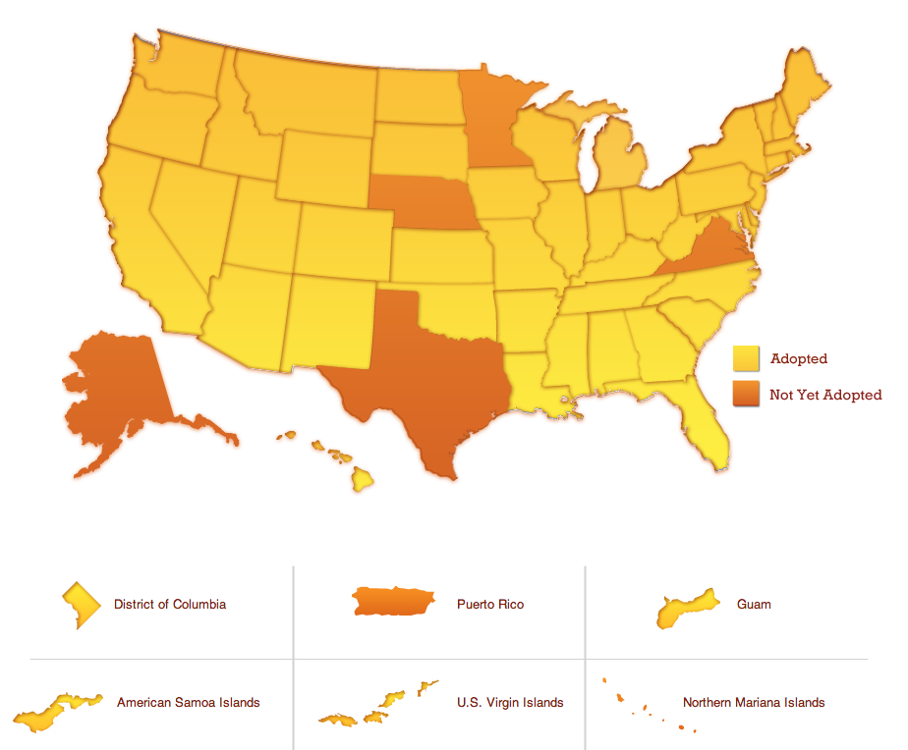
What are the Common Core State Standards?
• Identify the skills and knowledge students will need for college and the 21st century workplace
• Standards for English Language Arts and Mathematics
• Developed by teachers, parents, administrators, and experts, led by the National Governors Association
• Forty-five states, the District of Columbia, four territories, and the Department of Defense Education Activity have adopted the Common Core State Standards.

Slide 3


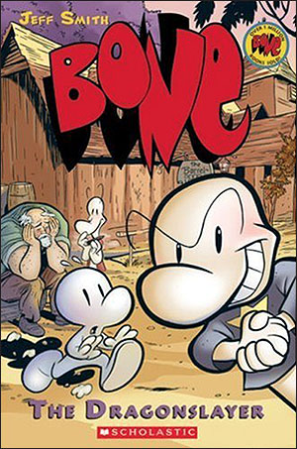
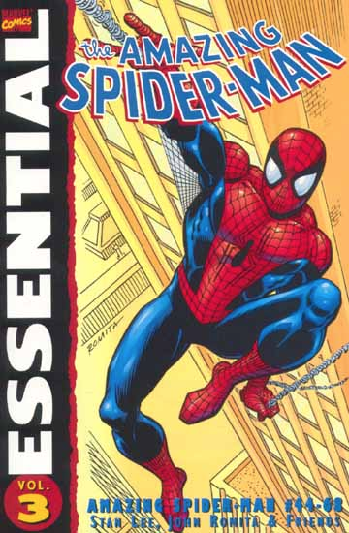

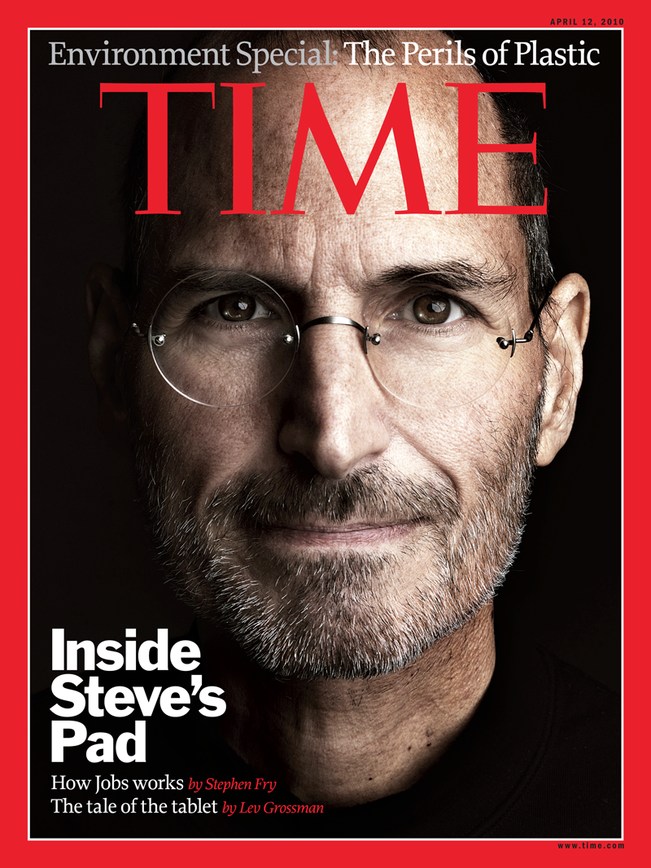
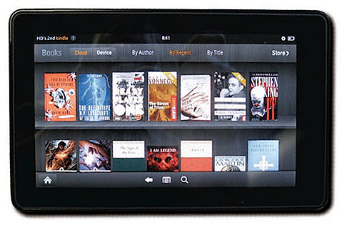
What do the Standards say about texts?
• A focus on results rather than means.
"Teachers are...free to provide students with whatever tools and knowledge their professional judgment and experience identify as most helpful for meeting the goals set out in the Standards."
• A range of text types and increasing complexity
"One of the key requirements of the Common Core State Standards for Reading is that all students must be able to comprehend texts of steadily increasing complexity as they progress through school."
Notes:
The standards don't tell teachers how to teach.

Slide 4
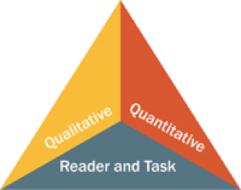
Reading: Text Complexity
The Standards require students to read and analyze increasingly complex texts. How is complexity measured?
Quantitative evaluation of the text
Qualitative evaluation of the text
• Levels of meaning
• Structure
• Language conventionality
• Knowledge demands
Matching reader to text and task

Slide 5
Quantitative Complexity
• CCSS cautions about relying on quantitative measures alone: Grapes of Wrath measures at Grades 2-3.
• Graphic texts often have a higher rare word count than other types of texts. (University of Oregon)
• Graphic texts often have a smaller word count over all and a shorter average sentence length. They can be missing some text conventions such as "She said," because dialogue is presented in word balloons.
• Lexile has a code for Graphic Novels (GN). "The impact of the pictures on reading comprehension is not captured in the Lexile measure of a graphic novel."

Slide 6
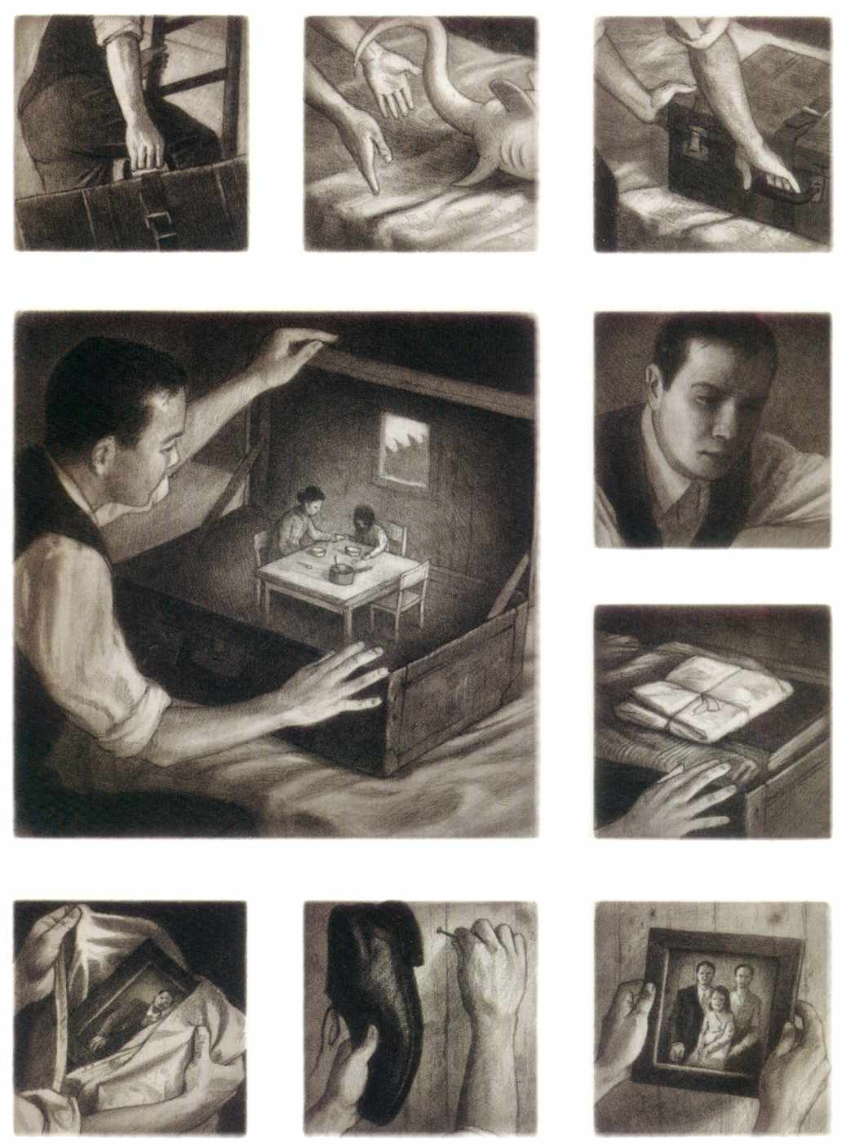
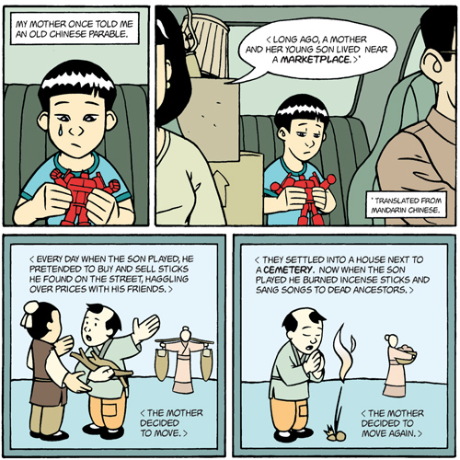
Qualitative evaluation of the text
Levels of meaning
"Literary texts with a single level of meaning tend to be easier to read than literary texts with multiple levels of meaning."
American Born Chinese
Gene Yang
The Arrival Shaun Tan
Notes:
ABC: symbolism of the toy, boy crying, boxes show moving, parable applicable to their situation

Slide 7
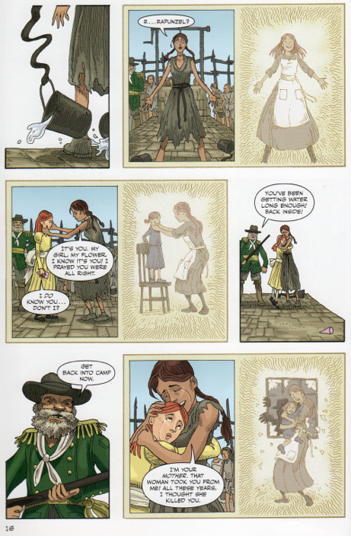
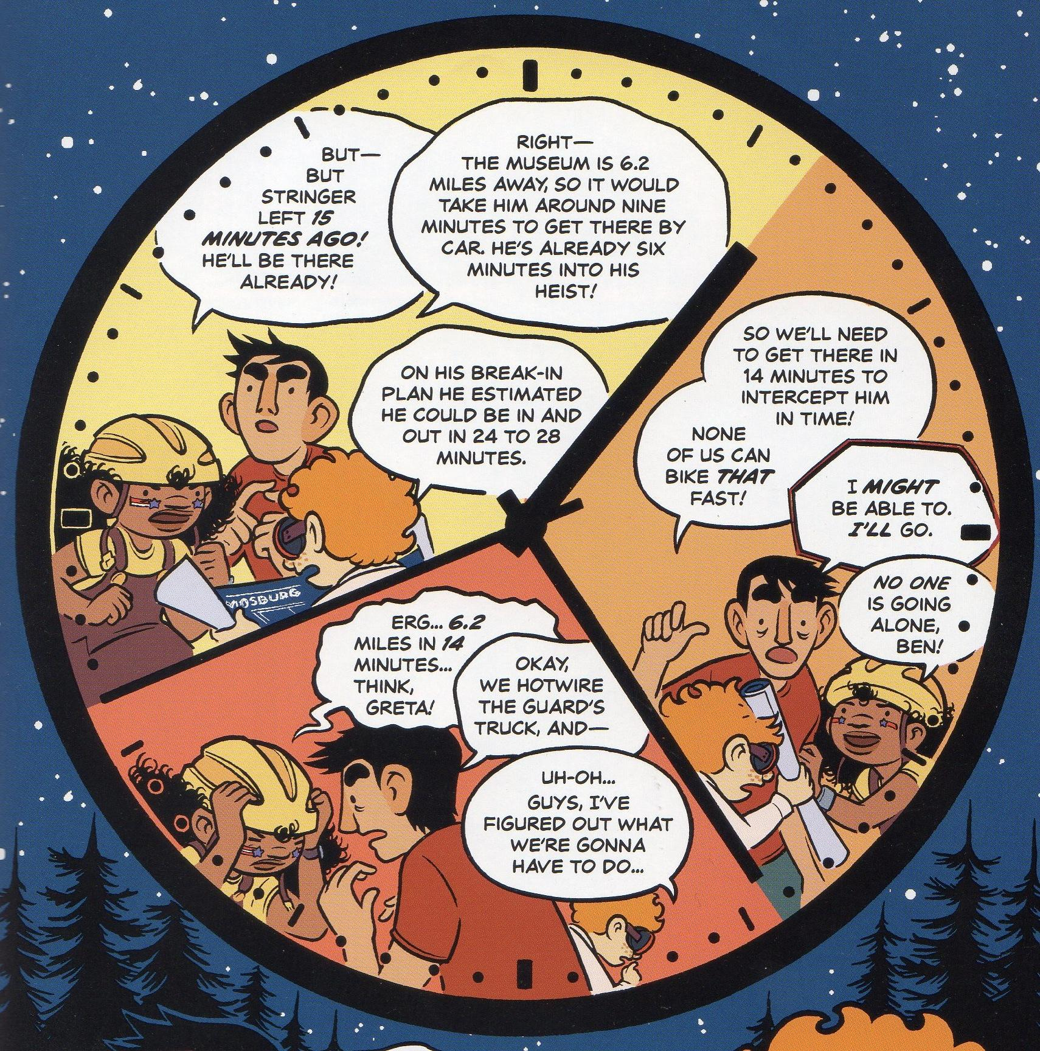
Qualitative evaluation of the text
Structure
• "Complex literary texts make more frequent use of flashbacks, flash-forwards, and other manipulations of time and sequence"
• "...texts of high complexity tend to have complex graphics, graphics whose interpretation is essential to understanding the text"
Rapunzel's Revenge
Shannon and Dean Hale
and Nathan Hale
The Secret Science Alliance and the Copycat Crook
Eleanor Davis

Slide 8
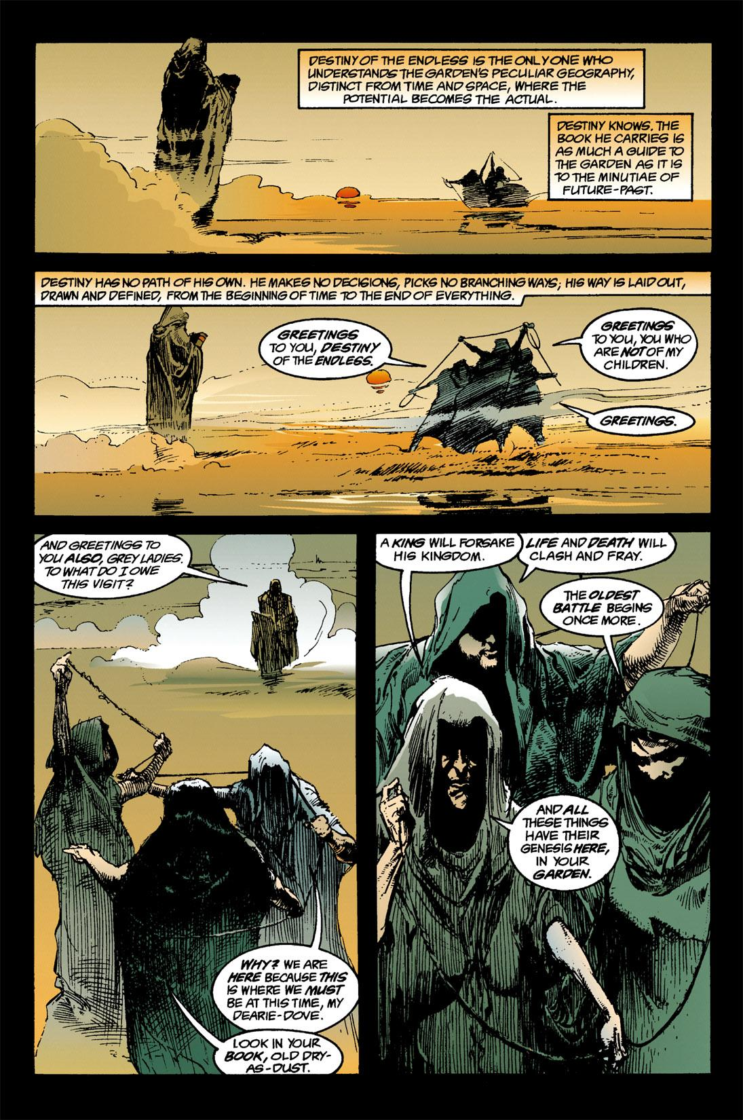
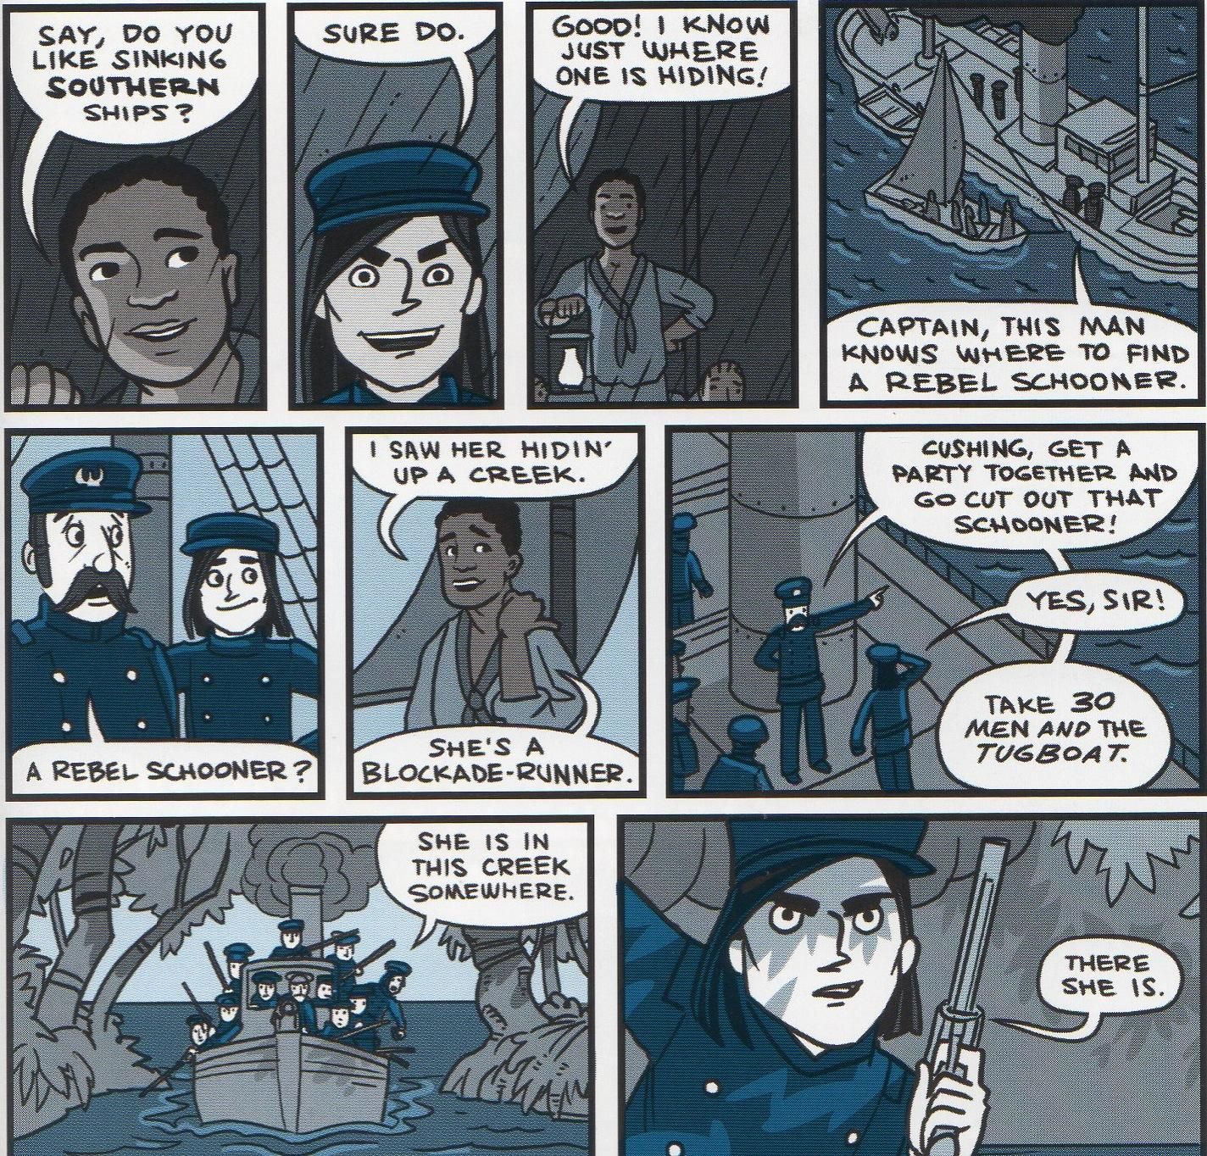
Qualitative evaluation of the text
Language conventionality and clarity
"...texts that rely on figurative, ironic, ambiguous, purposefully misleading, archaic or otherwise unfamiliar language or on general academic and domain-specific vocabulary"
Nathan Hale's Hazardous Tales: Big Bad Ironclad! Nathan Hale
Sandman: Season of Mists Neil Gaiman
Notes:
Hale: rebel, schooner, blockade
Sandman: garden, book, "destiny," "grey ladies," genesis

Slide 9
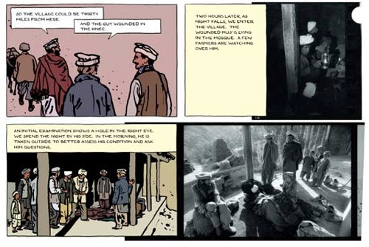
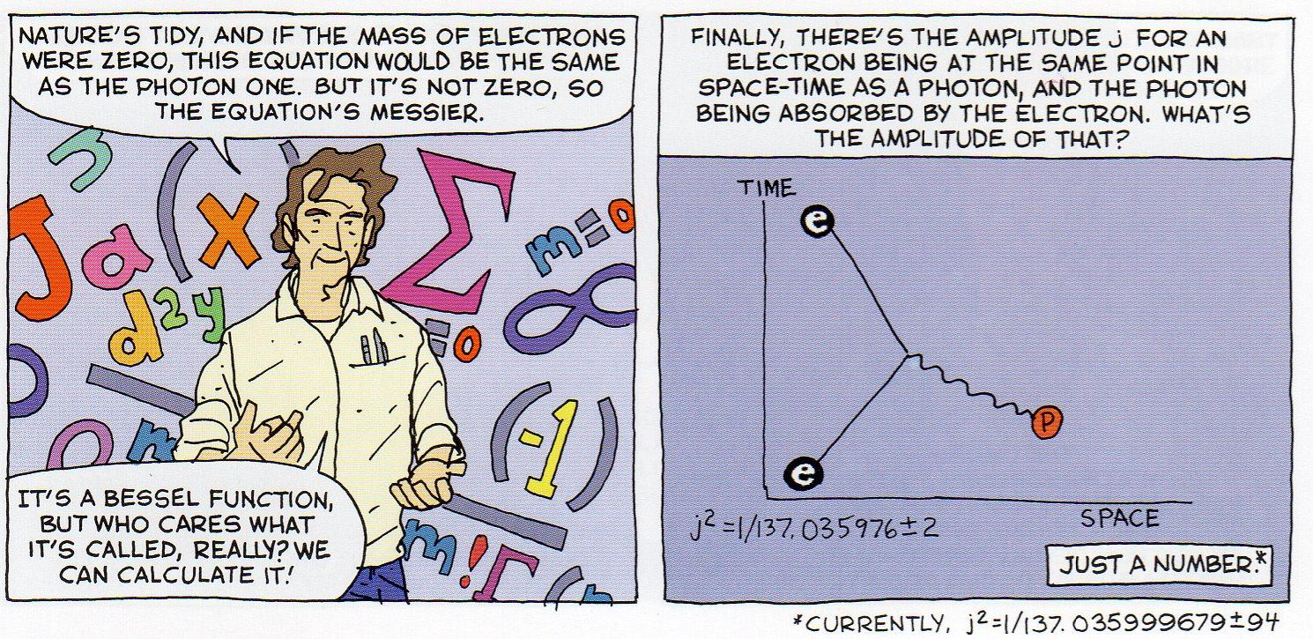
Qualitative evaluation of the text
Knowledge demands
"Literary texts that feature complex or sophisticated themes, multiple themes, multiple perspectives, perspectives unlike the reader's, and experiences distinctly different from the reader's experiences."
"Informational texts that require extensive, perhaps specialized discipline knowledge."
The Photographer Emmanuel Guibert
Feynman
Jim Ottaviani and
Leland Myrick

Slide 10
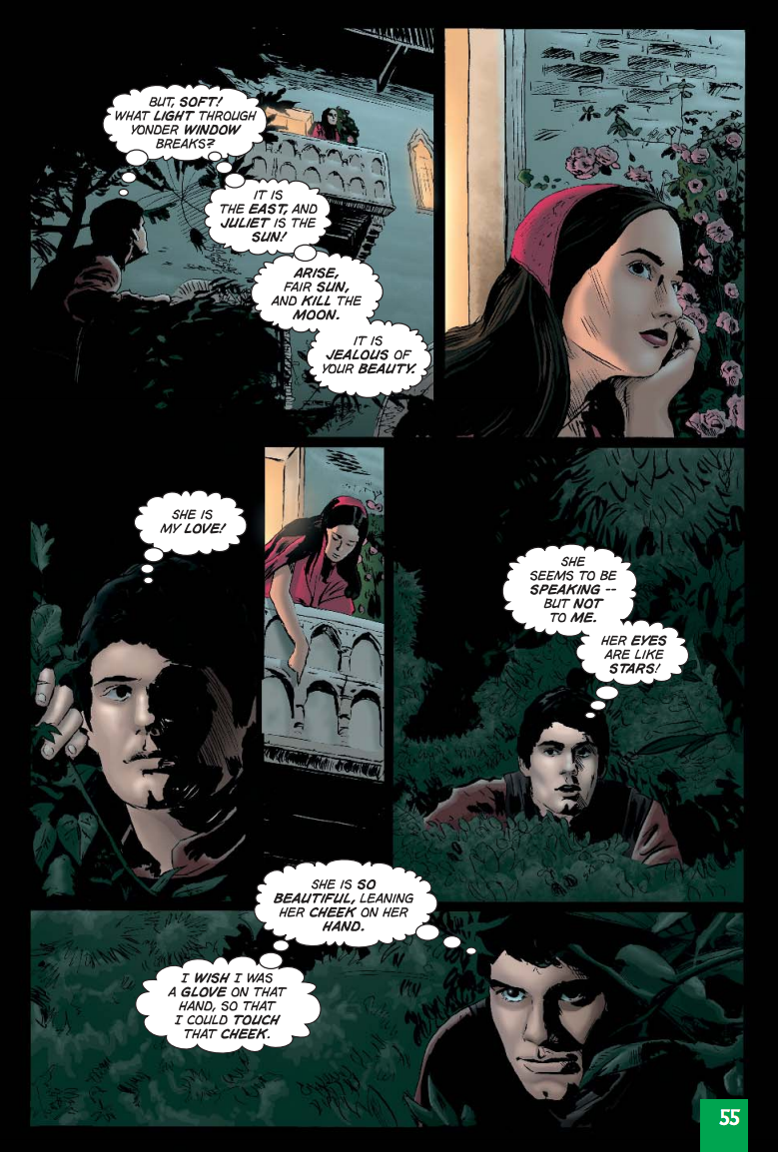
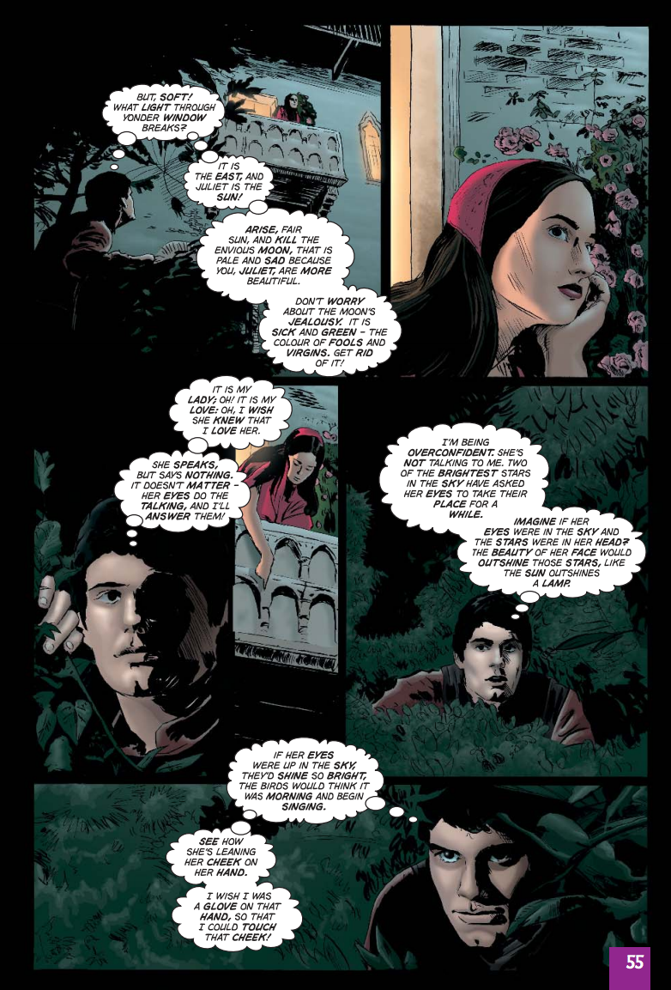
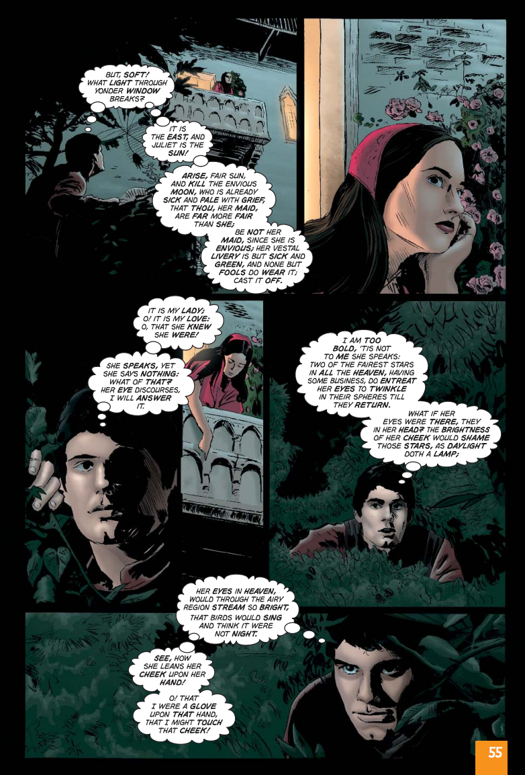
Matching reader to text and task
Reader variables:
-critical analytic ability
-inferencing
-visualization
-vocabulary
-interest and motivation
Classical Comics
Romeo and Juliet the Graphic Novel
Plain text, quick text,
and original text versions
Notes:
Graphic texts are great for visual learners, those intimidated by large blocks of text, and ELLs. They also offer a challenge to above-level learners.

Slide 11
Specific references to graphic novels in the Standards
Grade 5
Integration of Knowledge and Ideas: CCSS.ELA-Literacy.CCRA.R.5.7: Analyze how visual and multimedia elements contribute to the meaning, tone, or beauty of a text (e.g., graphic novel, multimedia presentation of fiction, folktale, myth, poem.)
Grades 6-12
Students in grades 6–12 apply the Reading standards to the following range of text types, with texts selected from a broad range of cultures and periods.
Literature |  |  | Informational Text
Stories | Dramas | Poetry | Literary Nonfiction and Historical, Scientific, and Technical Texts
Includes the subgenres of adventure stories, historical fiction, mysteries, myths, science fiction, realistic fiction, allegories, parodies, satire, and graphic novels | Includes one-act and multi-act plays, both in written form and on film | Includes the subgenres of narrative poems, lyrical poems, free verse poems, sonnets, odes, ballads, and epics | Includes the subgenres of exposition, argument, and functional text in the form of personal essays, speeches, opinion pieces, essays about art or literature, biographies, memoirs, journalism, and historical, scientific, technical, or economic accounts (including digital sources) written for a broad audience

Slide 12
Standards Applicable to Graphic Texts: Reading
Key Ideas and Details
CCSS.ELA-Literacy.CCRA.R.1 Read closely to determine what the text says explicitly and to make logical inferences from it; cite specific textual evidence when writing or speaking to support conclusions drawn from the text.
CCSS.ELA-Literacy.CCRA.R.2 Determine central ideas or themes of a text and analyze their development; summarize the key supporting details and ideas.
CCSS.ELA-Literacy.CCRA.R.3 Analyze how and why individuals, events, or ideas develop and interact over the course of a text.
Craft and Structure
CCSS.ELA-Literacy.CCRA.R.4 Interpret words and phrases as they are used in a text, including determining technical, connotative, and figurative meanings, and analyze how specific word choices shape meaning or tone.
CCSS.ELA-Literacy.CCRA.R.5 Analyze the structure of texts, including how specific sentences, paragraphs, and larger portions of the text (e.g., a section, chapter, scene, or stanza) relate to each other and the whole.
CCSS.ELA-Literacy.CCRA.R.6 Assess how point of view or purpose shapes the content and style of a text.
Integration of Knowledge and Ideas
CCSS.ELA-Literacy.CCRA.R.7 Integrate and evaluate content presented in diverse media and formats, including visually and quantitatively, as well as in words.¹
CCSS.ELA-Literacy.CCRA.R.8 Delineate and evaluate the argument and specific claims in a text, including the validity of the reasoning as well as the relevance and sufficiency of the evidence.
CCSS.ELA-Literacy.CCRA.R.9 Analyze how two or more texts address similar themes or topics in order to build knowledge or to compare the approaches the authors take.
Range of Reading and Level of Text Complexity
CCSS.ELA-Literacy.CCRA.R.10 Read and comprehend complex literary and informational texts independently and proficiently.
All of them!

Slide 13

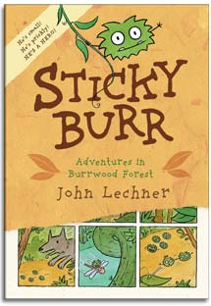
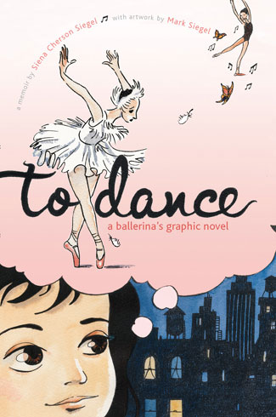
Examples of addressing Standards using graphic and traditional texts
Key Ideas and Details: Analyze how and why individuals, events, or
ideas develop and interact over the course of a text.
Grades K-3
Graphic texts: • The Arrival by Tan • Sticky Burr by Lechner
• To Dance: A Ballerina's Graphic Novel by Siegel and Siegel
Traditional texts: • Are You My Mother? by Eastman
• The Story of Ruby Bridges by Coles • Green Eggs and Ham by Dr. Seuss
Activity: Draw a picture and write (or dictate) a description of the most important characters or characters in the story. Write, dictate, or draw events and ideas related to each character. Write or orally state how these characters, events, and ideas interact over the course of the text.

Slide 14
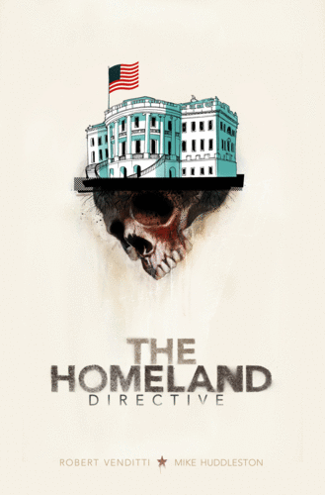
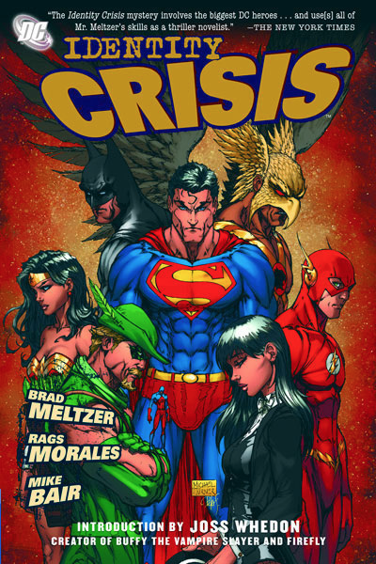
Examples of addressing Standards using graphic and traditional texts
Key Ideas and Details: Read closely to determine what the text says explicitly and to make logical inferences from it; cite specific textual evidence when writing or speaking to support conclusions drawn from the text.
Grades 6-12
Graphic texts: • Identity Crisis by Meltzer, Morales, & Blair
• The Homeland Directive by Venditti and Huddleston
Traditional texts: • Alice in Wonderland by Carroll • Native Son by Wright
Activity: The suggested texts are high-quality texts for teaching inference, especially reliance on textual evidence that builds to support plot twists and turns. Have students create a T-chart. Ask students to list the “INFERENCES” they are forming as they read on the left side of the T-chart. Then, on the right side of the T-chart, students can list the “TEXTUAL EVIDENCE” that supports their inferences.

Slide 15
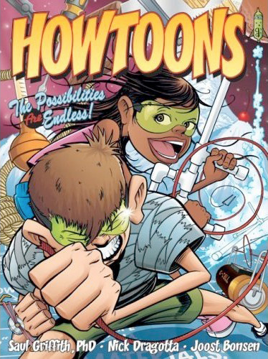
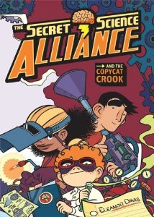
Examples of addressing Standards using graphic and traditional texts
Integration of Knowledge and Ideas: Integrate and evaluate content presented in diverse media and formats, including visually and quantitatively, as well as in words.
Grades 3-5
Graphic texts: • The Secret Science Alliance by Davis
• Howtoons! The Possibilities are Endless by Griffith,
Bonsen, & Dragotta
Traditional texts: • My Librarian is a Camel by Margriet
• About Time: A First Look at Time and Clocks by Koscielniak
Activity: To help students notice unique format choices, take a book walk as a class, pointing out each time you notice a new formatting choice. Then, as students read the texts on their own, ask them to go on a treasure hunt, searching for even more unique choices and decisions made by the author. Have students share what they find.

Slide 16

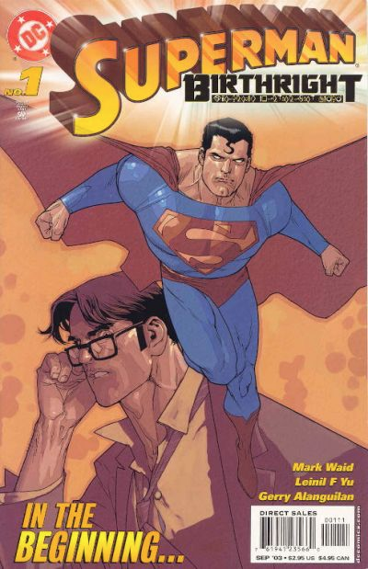
Examples of addressing Standards using graphic and traditional texts
Integration of Knowledge and Ideas: Analyze how two or more texts address similar themes or topics to build knowledge or to compare the approaches the authors take.
Grades 6-12
Graphic texts: • Maus I by Spiegelman
• Superman Birthright by Waid, Yu, & Alanguilan
Traditional texts: • The Outsiders by Hinton
• The Diary of a Young Girl by Frank
Activity: Perfect for pairing a graphic novel with a traditional text-only novel, this CCS is best handled by encouraging students to create a Word or Excel document that highlights the themes or topics found in each text. When their documents have been completed, ask students to write an essay that compares the approaches of each author.

Slide 17
The Takeaway...
Graphic novels are complex texts,
uniquely suited for addressing
Common Core Reading standards.
Much more information at www.ReadingWithPictures.org

